Slide 1
A Deep Learning Approach to Recognize Handwritten Telugu Character Using CNN
CS 342

Slide 2
Roles and Responsibility
B. Sreekar | CNN , Support Vector Machine
T. Prudhvith | CNN , MultiLayer Perceptron
P. Chaitanya | CNN, Bayesian Classifier
* Refinements are done by all of us!

Slide 3
Proposed Work
In the proposed work, we suggest and evaluate a classic Convolutional Neural Network (CNN) and various algorithms for the identification of Telugu characters.

Slide 4
Scope
Handwriting differs from person to person; hence, it is a tedious task to recognize the handwriting characters. In pattern recognition field, Handwriting Recognition (HR) has become a recent research area of interest due to the exponential usage of the resources, hence Neural Networks are vastly used in the field of Pattern Recognition.

Slide 5
Methodology
We have used Convolutional Neural Network (CNN), a deep learning construction for recognition of handwritten Telugu Characters which holds an input, convolutional, rectified linear unit, pooling layer and fully connected layer continued by an output layer.

Slide 6
Analysis

Slide 7
Data Exploration
The dataset is downloaded from HP Labs India website [1]. This dataset contains approx. 270 samples of 11 Telugu "characters".
The characters are made available for download as TIFF files. The original unequally sized rectangular images are resized into 128*128 gray scale images and saved them as JPG files.

Slide 8
Algorithms & Techniques

Slide 9
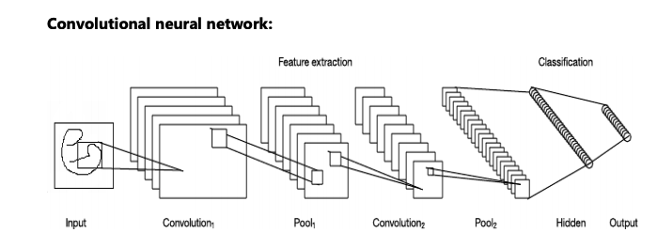

Slide 10
Input ----------- 4D tensor with shape (n, 80, 80, 1) where n is the number of input images and the number of channels is 1 as the images are binary. (Number of channels = 3 if the images are RGB).
Layer 1 --------- Convolutional Layer with 32 filters and filter size 3 x3 and Max pooling layer with filter size 2 x 2.
Layer 2 --------- Convolutional Layer with 64 filters and filter size 3 x 3 and Max pooling layer with filter size 2 x 2.
Layer 3 --------- Convolutional Layer with 128 filters and filter size 3 x 3 and Max pooling layer with filter size 2 x 2.
Flatten( ) -------- It converts the output of the convolutional part of the CNN into a 1 dimensional feature vector, to be used by the fully connected layer.
Layer 4 --------- Fully Connected layer (Dense) with 256 neurons, with dropout regularization rate of 0.4 (probability of 0.4 that any given element will be dropped during training).
Layer 5 --------- Fully Connected layer (Dense) with 138 neurons.
Here, linear activation RELU is used for the convolution and max pooling layers and SOFTMAX activation is used for the output layer (Fully Connected Layer).

Slide 11
Refinement

Slide 12
Exp | Structure | Image size | Optimizer | Accuracy
1st | 3 Conv layers, with zero-padding and max-pooling by 2 fully connected layers | 32 * 32 | sgd | 70.8
2nd | 3 Conv layers, with zero-padding and max-pooling by 2 fully connected layers | 32 * 32 | adam | 73.5
3rd | 3 Conv layers, with zero-padding and max-pooling by 2 fully connected layers | 64 * 64 | sgd | 82.3
4th | 4 Conv layers, with zero-padding and max-pooling by 2 fully connected layers | 64 * 64 | adam | 82.9
5th | 4 Conv layers, with zero-padding and max-pooling by 2 fully connected layers | 80 * 80 | sgd | 92.4
Model - CNN || Training Epochs - 50 || Loss - Categorical cross entropy

Slide 13
Results

Slide 14
Benchmarks
We got test accuracy of 94% and training accuracy of 97% on Telugu character dataset with 50 epochs, if we increase number of epochs, then the accuracy will increase further.
The loss reduced as the training progressed. For the first few epochs, the training accuracy is less than the validation accuracy and then after some epochs, train accuracy increased.

Slide 15
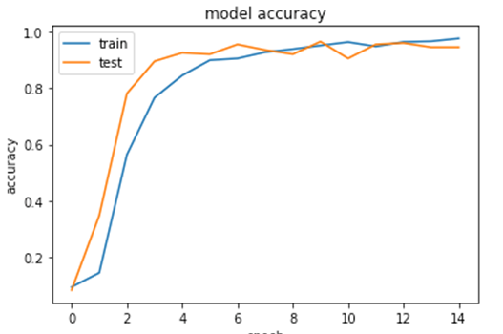
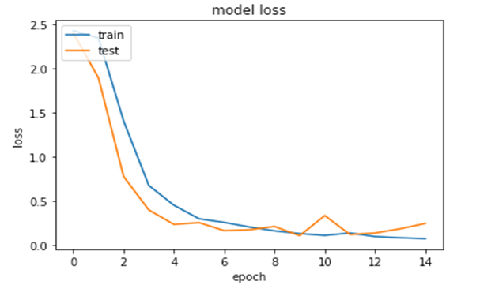
Model Evaluation & Validation

Slide 16
CNN Vs Other models
Method | Accuracy
CNN (Proposed Method) | 94%
[1] Support vector machine | 71%
[2] Multi Layer Perceptron | 85%
[3] Bayesian Classifier | 87.5%

Slide 17
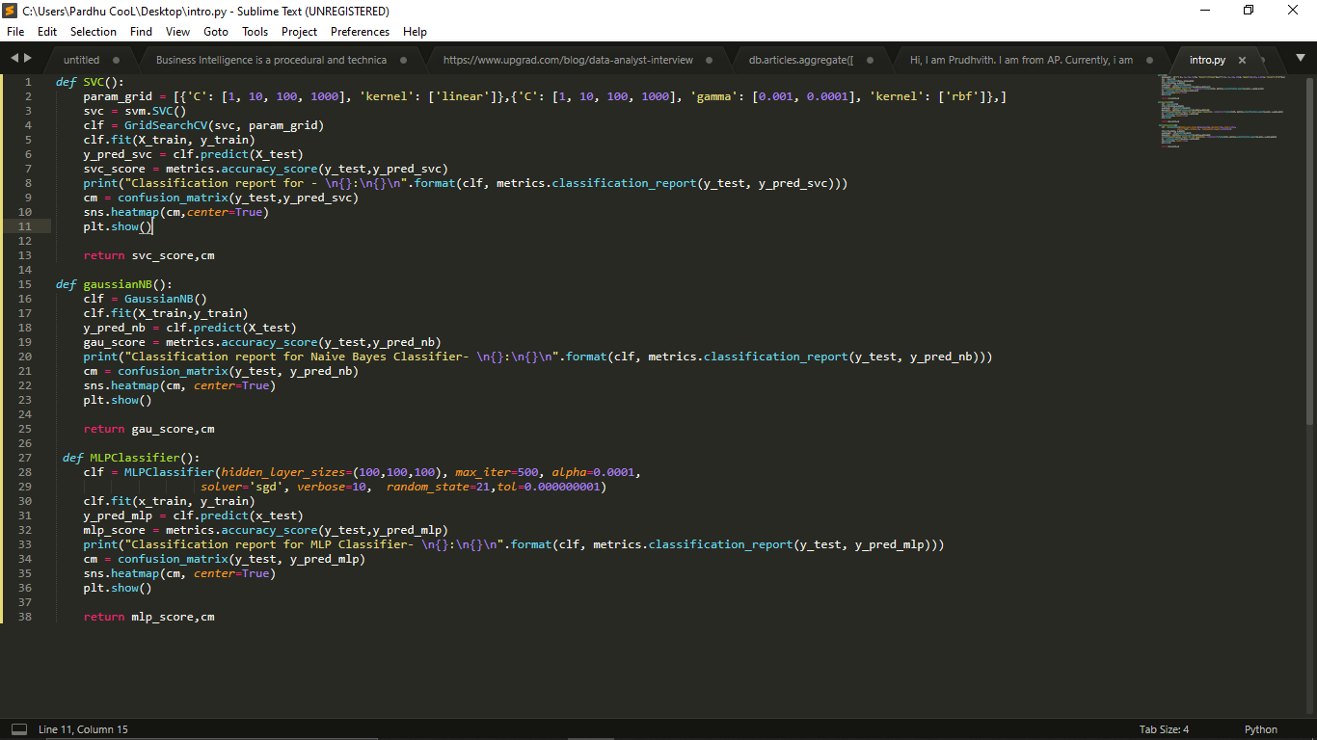

Slide 18
Conclusion
In this proposed work, we projected a deep convolutional neural network character image into 166 classes contained in 270 samples. A new architecture was proposed that captures the low-level textual features of the handwritten characters.
The method can be further extended to multiple classes (i.e., vattu, gunintham) and can improve recognition accuracy even on a bigger dataset.

Slide 19
THANK YOU

